Slide 1

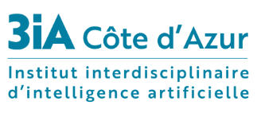

Swin Transformers^{[1]}
Research Paper:
Presented by:
Marina Díaz Uzquiano
Bhargav Ramudu Manam
M.Sc. Data Science & Artificial Intelligence
Supervised by:
François Brémond & Co.
STARS Team
INRIA- Sophia Antipolis
[1] Swin Transformer: Hierarchical Vision Transformer using Shifted Windows, Liu et al., Microsoft Research Asia, ICCV 2021

Slide 2
Contents
Introduction
Related Work
Architecture
Results
Conclusion

Slide 3
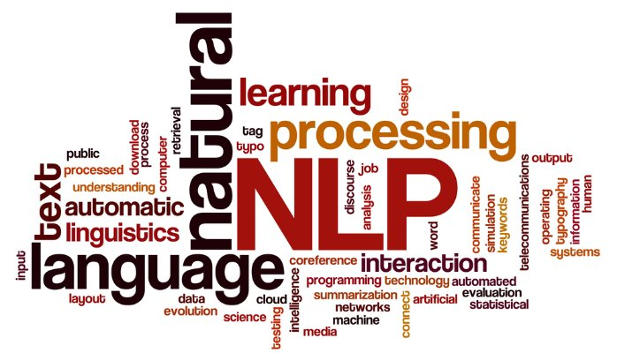
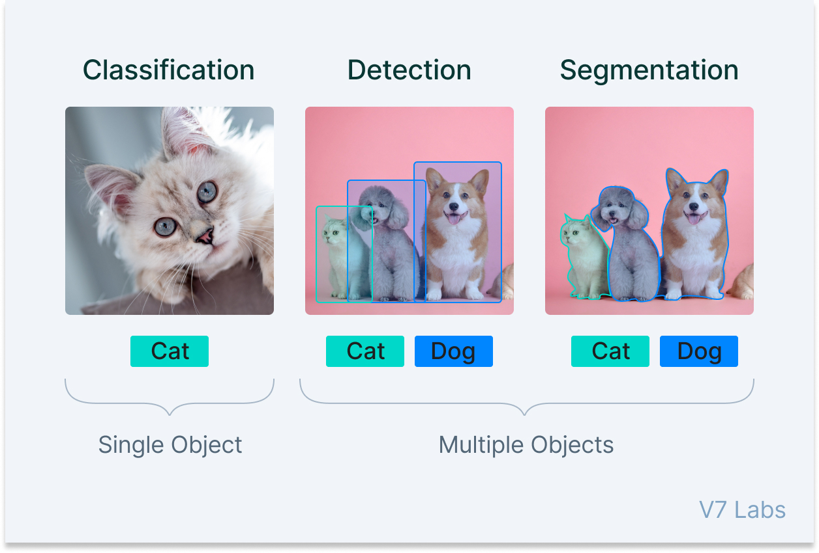
Motivation
To build a general-purpose backbone for CV tasks based on Transformers.
To replace CNN backbones in the existing models.
SOTA
[2]
Transformers
SOTA ?
[3]

Slide 4
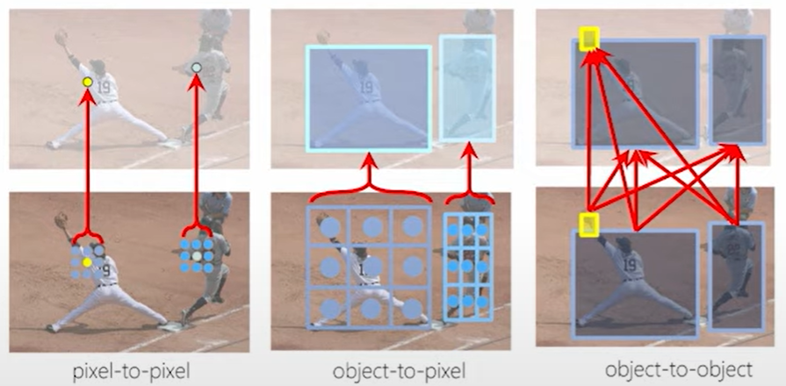
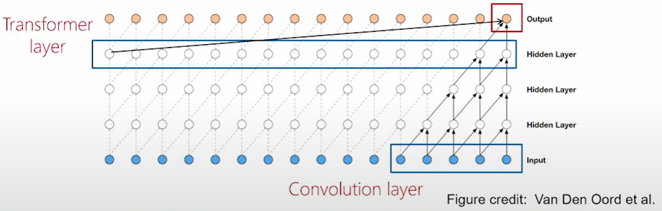
Why Transformers?
General Modelling Capability
pixel-to-pixel, object-to-pixel & object-to-object relationships.
Complement Convolution
global relations over local relations
Scalability
Multi-modality modelling
Unification of CV & NLP
[4]
Transformer: global relations, CNN: local relations

Slide 5
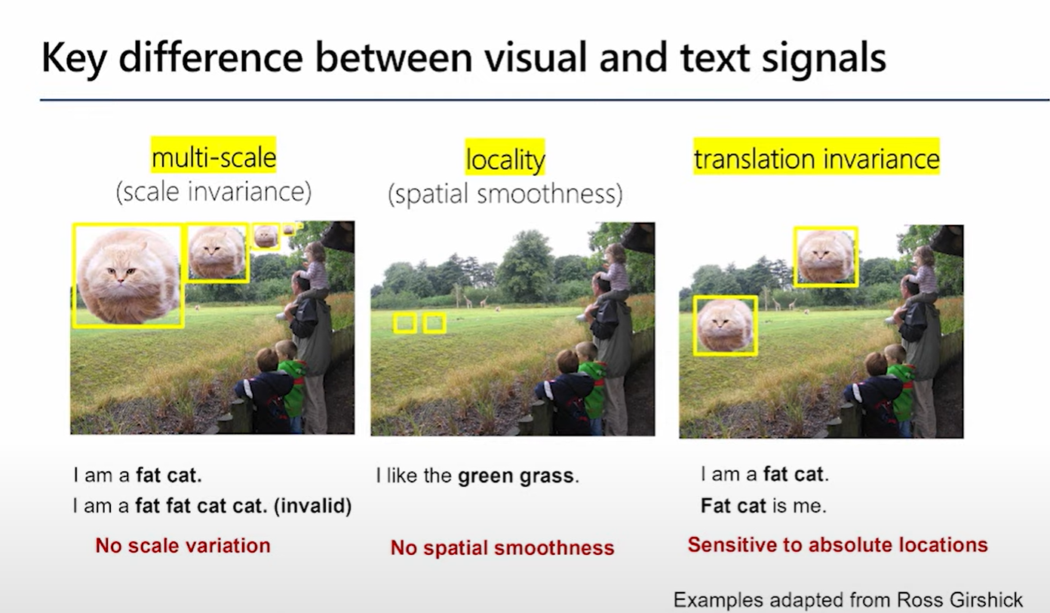
Challenges
Adapting Transformers: NLP to CV
Scale
NLP: same scale for all word tokens
CV: multi-scale
Locality
Translational Invariance
High Resolution
Attention: Quadratic w.r.t #pixels
Dense prediction intractable

Slide 6
Related work
CNN based: current SOTA
AlexNet, VGG, GoogleNet, ResNet, DenseNet, HRNet, Efficient Net, etc.
Self-attention based[4]:
Local (window) attention
slightly better accuracy/FLOPs trade-offs than the counterpart ResNet architecture.
Drawbacks:
Sliding windows: costly memory access

Slide 7
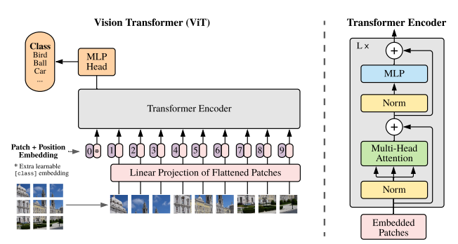
Related work
Transformer based:
Vision Transformer (ViT) [5]
16x patches, Transformer layers
Impressive speed-accuracy trade-off on image classification over CNNs.
Drawbacks:
Requires huge datasets
Low resolution feature maps
not suitable as a backbone on dense tasks.
High resolution input
Quadratic complexity
[5]

Slide 8
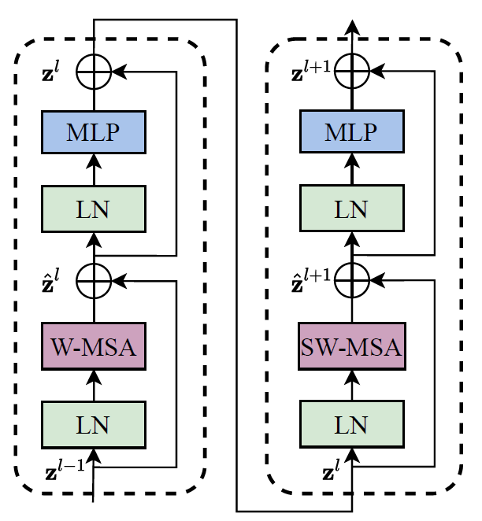
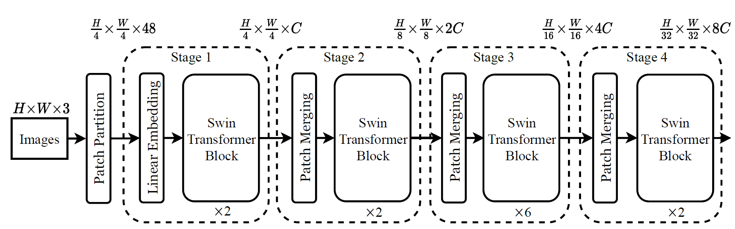
Architecture
The architecture of a Swin Transformer (Swin-T)
Two successive Swin Transformer Blocks

Slide 9
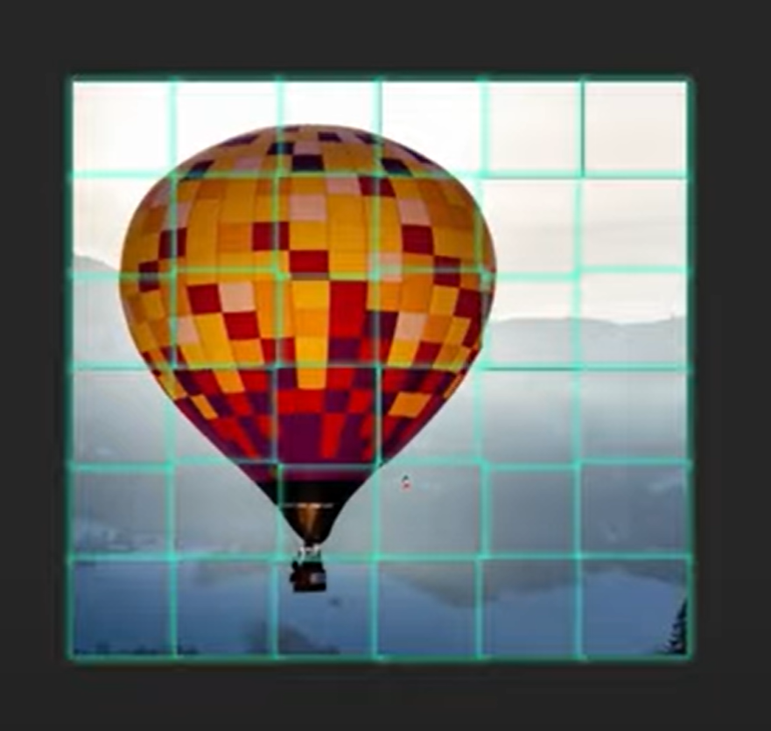
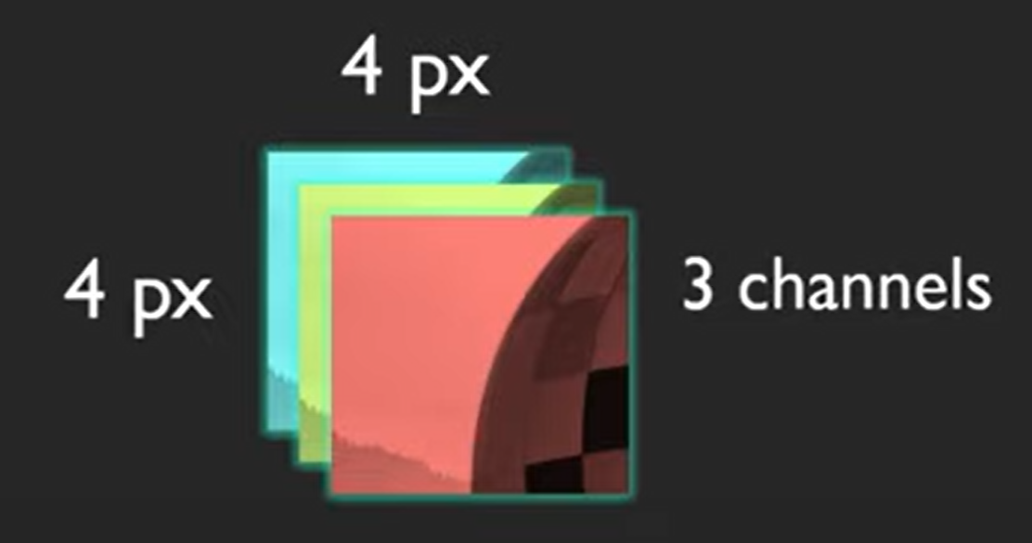
Patch Partition
Patch size = 4 x 4

Slide 10
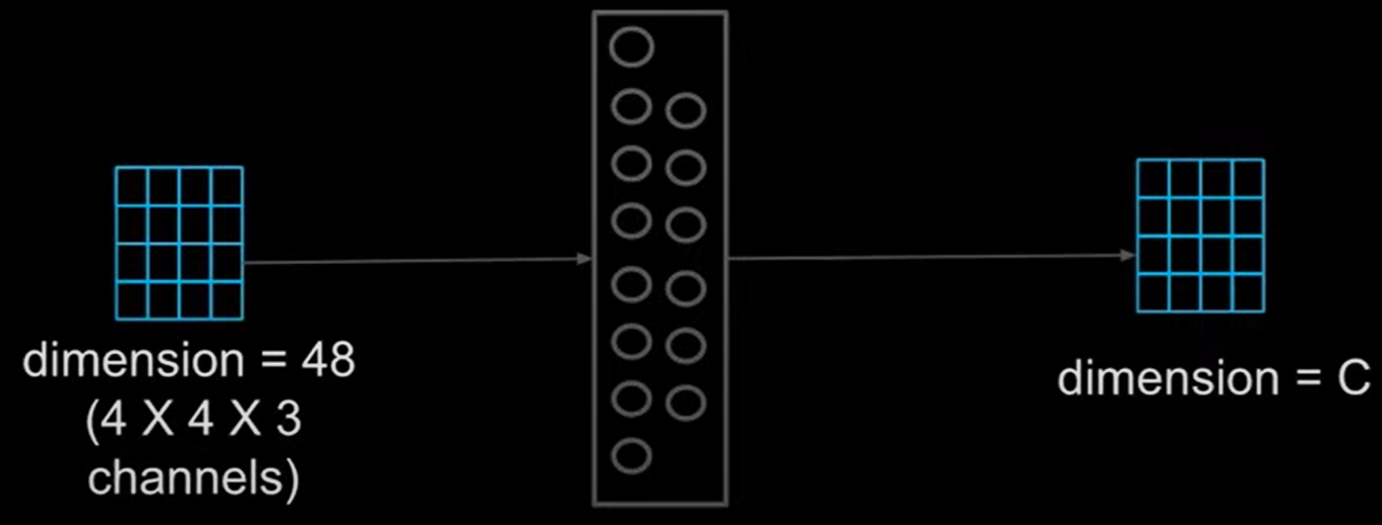
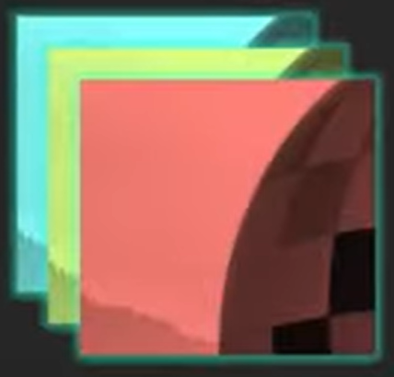

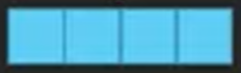
Linear Embedding

Slide 11
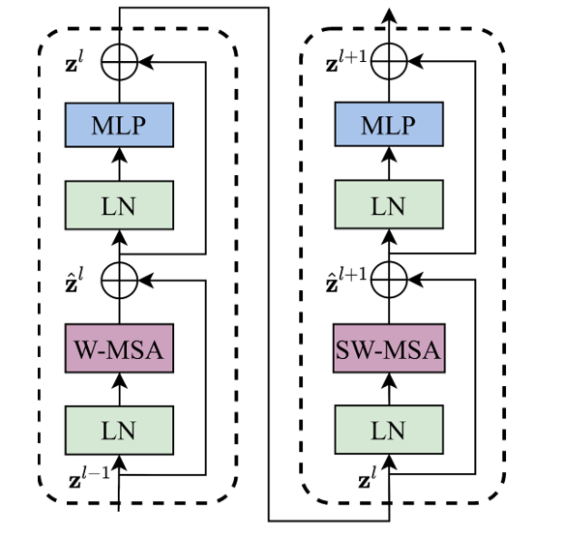
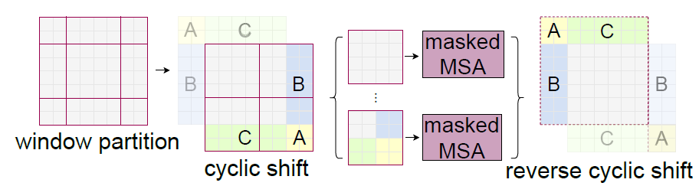
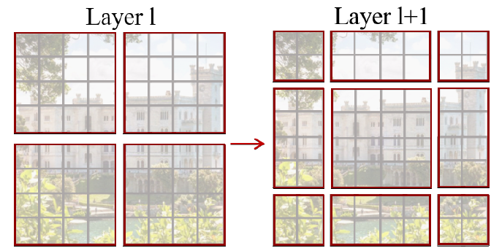
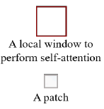
Swin Transformer Block
Regular window
Shifted window
Efficient batch computation approach for self-attention in shifted window partitioning.

Slide 12
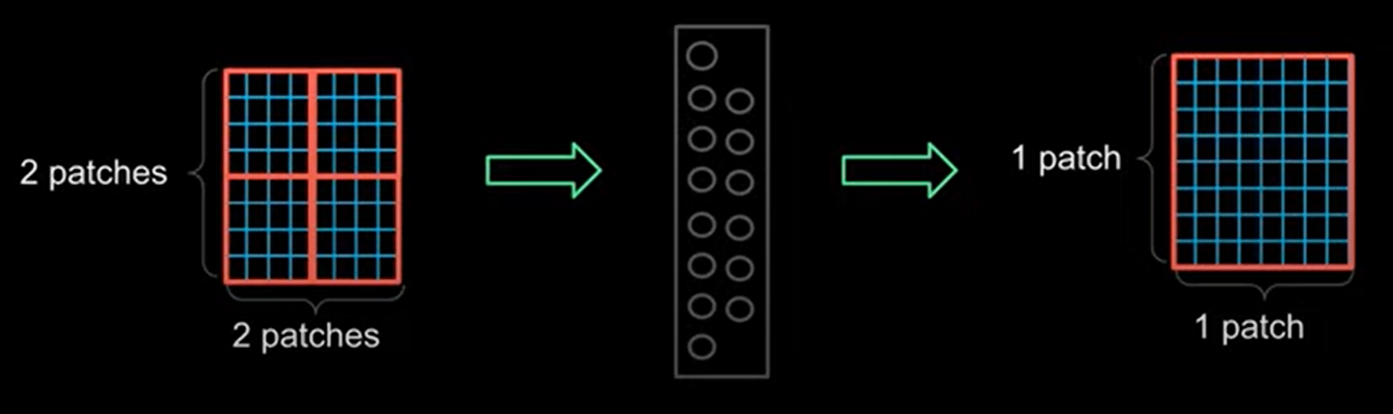
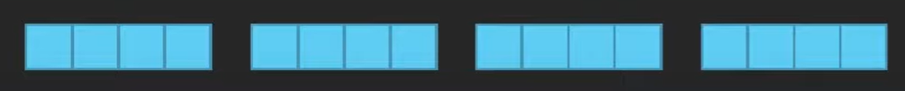
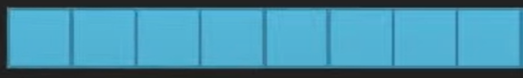
Patch Merging
C
C
C
C
2C

Slide 13
Architecture Variants
Model (Name) | C | Layer numbers | Size & Complexity
Swin-T (Tiny) | 96 | (2; 2; 6; 2) | 0.25 x Swin-B
Swin-S (Small) | 96 | (2; 2; 18; 2) | 0.5 x Swin-B
Swin-B (Base) | 128 | (2; 2; 18; 2) | 1 x Swin-B
Swin-L (Large) | 192 | (2; 2; 18; 2) | 2 x Swin-B

Slide 14
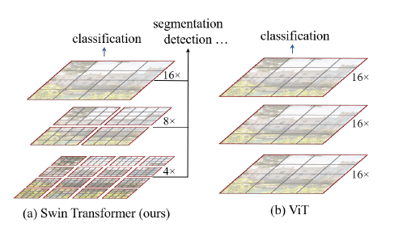
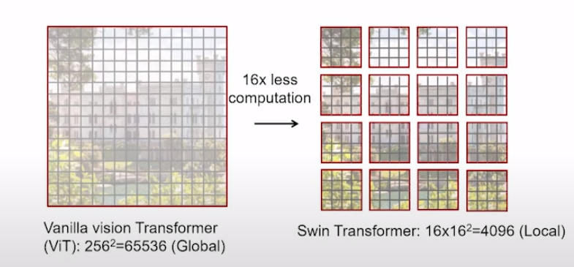
Contribution & Novelty
Introduced Hierarchical Architecture in Transformers
Patch Merging in deeper layers
Linear computational cost w.r.t image size
Window attention
Shifted Windows Multi-head Self Attention (SW-MSA)
Long-range dependencies
O((hw)²)
O(M²hw)

Slide 15
Contribution & Novelty
Successfully addresses the challenges in adapting Transformers for vision tasks
Hierarchal Architecture Scale Invariance
Non-overlapping windows Locality
Shifted window attention Translational semi-invariance

Slide 16
Experiments
ImageNet1K Image Classification
COCO Object Detection and instance Segmentation
ADE20K Semantic Segmentation

Slide 17
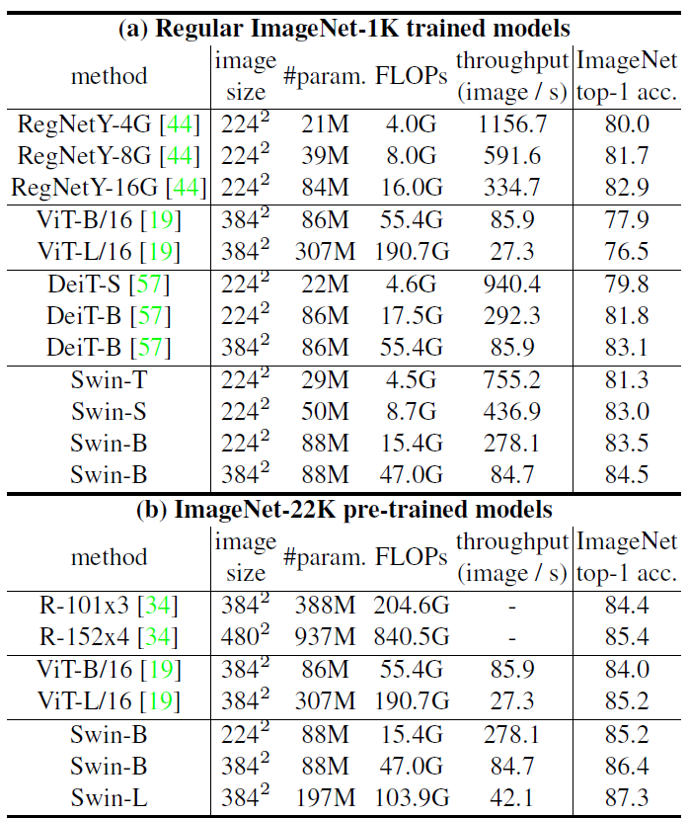
Results
Image Classification:
ImageNet-1K:
Regular ImageNet-1K trained models
Surpass DeiT for similar complexities
Slightly better speed-accuracy trade-off w.r.t RegNet
ImageNet-22K pre-trained models
Swin-B: 1.7% gain over regular model
Better speed-accuracy trade-off w.r.t ViT
Swin-L achieves the best accuracy

Slide 18
Results
Object detection:
COCO:
58.7 box AP and 51.1 mask AP
surpasses the previous SOTA by a margin of +2.7 box AP and +2.6 mask AP
Semantic Segmentation:
ADE20K:
53.5 mIoU on ADE20K
surpasses the previous SOTA by a margin of +3.2 mIoU on ADE20K

Slide 19
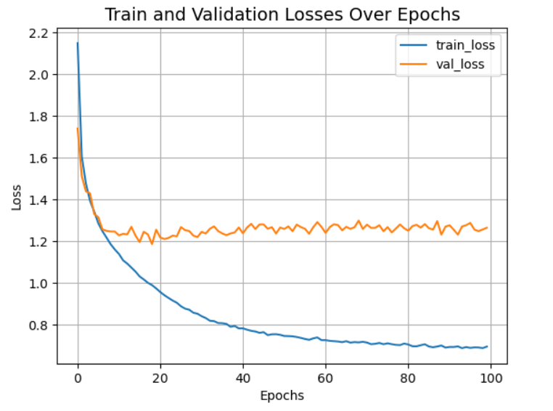
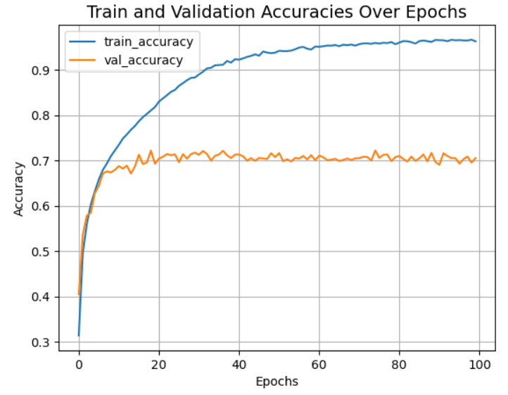
Our baseline model
Image Classification:
CIFAR-10:
10 Classes
Training data: 50k
Validation data: 10k
Model:
Input image: 32 x 32 x 3
Patch: 2 x 2
C = 96
Window: 2 x 2
MLP layer size = 256
Learning Rate = 0.001
Tuning and some regularization required!
Only local attention
Training from scratch huge model (450K parameters) not suitable for a small dataset
Implemented without patch merging due to time constraints (millions of parameters)

Slide 20
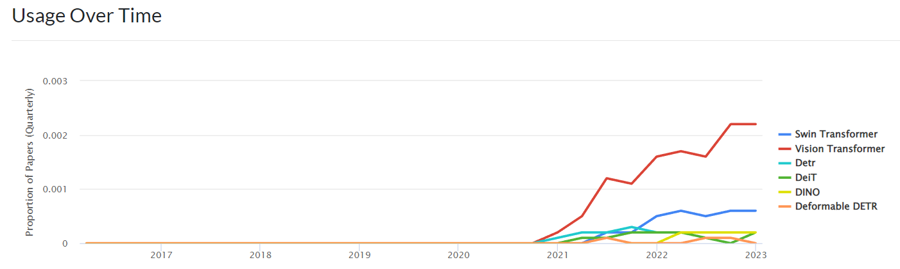
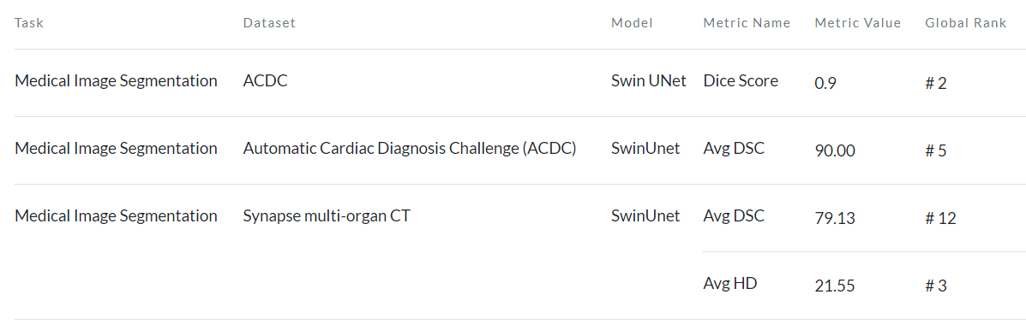
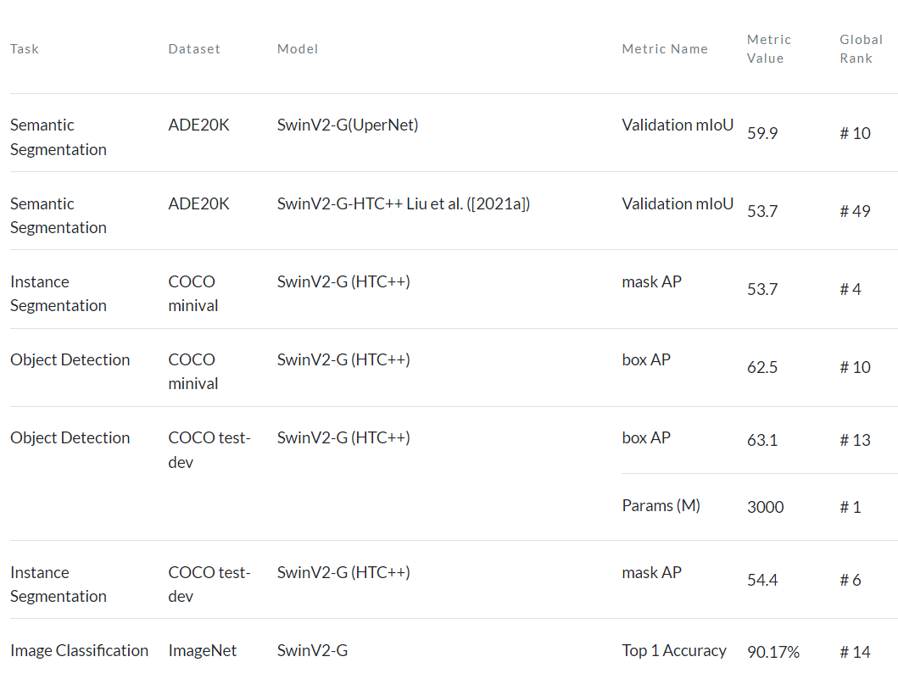
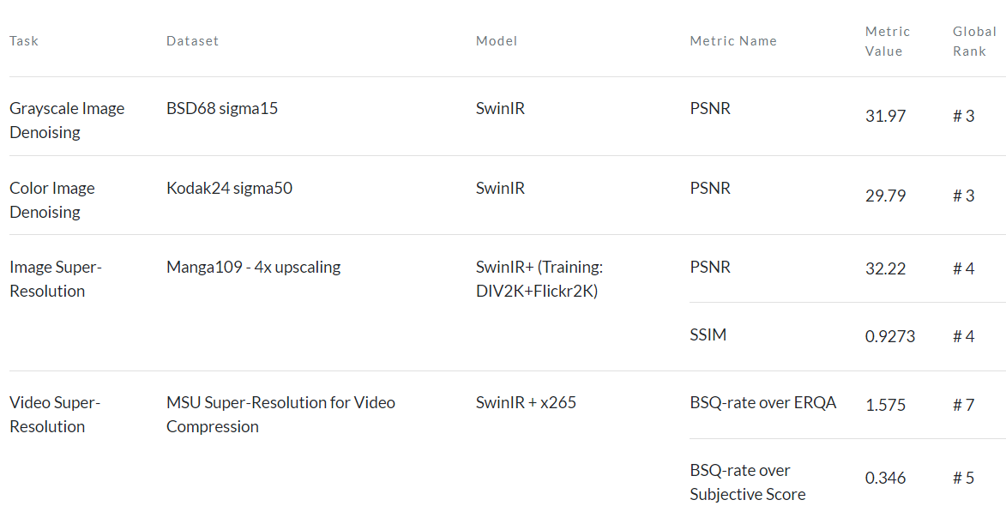








Impact
Usage over time:

Slide 21
Conclusion
Results demonstrate the potential of Transformer-based (Swin) models as vision backbones.
CNN based backbones are still the SOTA for most of the CV tasks, but transformers are getting there!
Drawback:
Shifting Windows Technique does not guarantee translational invariance
Helps in identifying pixel relationships only in neighboring patches but cannot model very-long range dependencies.

Slide 22

Thank you

